Slide 1
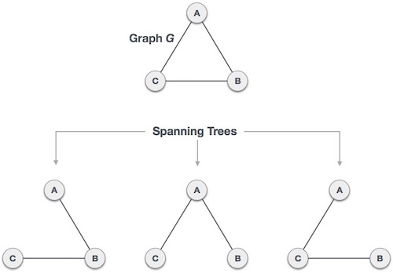
Spanning Tree
A spanning tree is a subset of Graph G<V,E>, which has all the vertices (V) covered with minimum possible number of edges.
In spanning tree S ⊆ G, S=<V’,E’>: V’=V and |E’|=|V|-1
A spanning tree does not have cycles, and it cannot be disconnected.

Slide 2
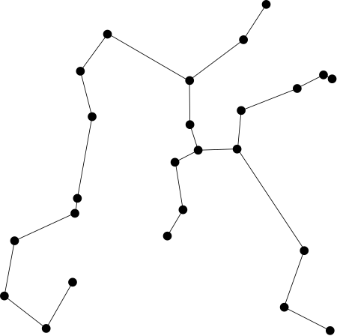
One Application of Minimum Spanning Tree
Electronic circuit designs often need to wire the pins of several components together.
To connect n pins, we can use an arrangement of n-1 wires. Using the least amount of wire is usually the most desirable.
We can model this wiring problem with a connected, undirected graph G.

Slide 3
Minimum Spanning Tree (MST)
A simple (undirected and connected) graph G<V,E> is a graph with a limited set of vertices (V) and a set of edges (E).
A minimum spanning tree in a weighted graph is:
a sub-graph of graph G that is a tree and
includes all vertices and
has the minimum cost (the sum of the weights in the tree)
How to find a minimum spanning tree in a graph?
Brute-force approach: search all possible spanning trees, then pick minimum exponential cost!

Slide 4
Greedy: Minimum Spanning Tree
Using greedy algorithm to find MST:
Prim’s Algorithm
Kruskal’s Algorithm

Slide 5
Cut property
Let S be any subset of nodes, and let e be the min cost edge with exactly one endpoint in S. Then the MST contains e.
S
e
e is in the MST

Slide 6
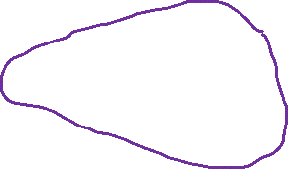
Cutset
A cut is a subset of nodes in set S. The corresponding cutset D is the subset of edges with
exactly one endpoint in S.
Or it is a set of edges that, when removed from a graph, separates the graph into two disjoint subsets.
2
3
1
6
4
S = { 4, 5, 8 }
Cutset D = 5-6, 5-7, 3-4, 3-5, 7-8
S
5
7
8
D

Slide 7
Prim’s Algorithm
Initialize S = any node
Apply cut property to S
Add min cost edge to cutset, and add the new explored node u to S
S
u

Slide 8
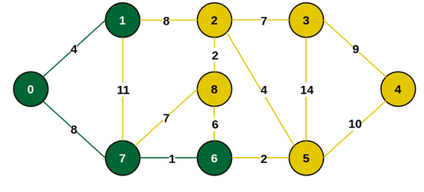
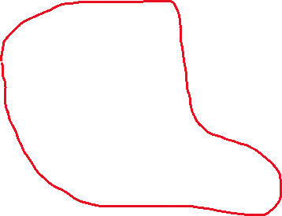
Do we need to worry about cycles?
Prim's algorithm never faces cycle issue.
The logic of Prim's automatically ensures that: You only add an edge that connects a vertex inside the MST to a vertex outside it.
You never add an edge between two vertices that are both already in the MST, which is what would create a cycle.

Slide 9
Greedy Algorithm for Prim’s Algorithm
F = ∅
S = {v₁} //any arbitrary vertex
while (instance not solved)
{
select vertex in V – S nearest to S; //min cost
add the vertex to S;
add the edge to F;
if (S == V)
the instance is solved;
}

Slide 10
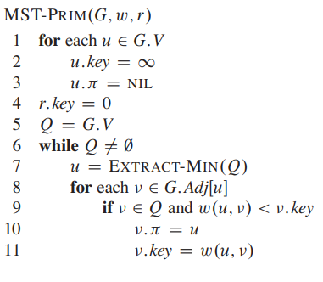
Implement Prim’s Algorithm
r is an arbitrary vertex,
w is the edges weight
Set the key of each vertex to ∞ except one (r)
u.π is the parent of u
Q is the min-priority queue
EXTRACT-MIN: Identifies a light edge that crosses the cut. In the first time: u=r

Slide 11
Time Complexity of Prim’s Algorithm
O(VlogV + ElogV)
O(V)
O(VlogV)
O(E)
O(ElogV)
O(logV)
DECREASE-KEY from min-heap

Slide 12
Time Complexity of Prim’s Algorithm
O(VlogV + ElogV)
In a sparse graph, we can say: E≈V
In a dense graph, E can be as large as V²
Thus, E≥V in practical scenarios
This means that O(Vlog⁡V) is dominated by O(Elog⁡V), and the overall complexity can be simplified to: O(Elog⁡V)

Slide 13
Kruskal’s Algorithm
Another greedy algorithm for finding MST:
It starts with partitioning vertices to subsets of one element
It sorts the edges in the ascending order
Starts with the minimum weight edge
At each step it adds a new edge and merges the subsets
an explicit check is required to avoid cycles
Continues until all subsets are merged into a single set

Slide 14
Kruskal’s MST Algorithm
Kruskal(Graph G):
A = ∅
Sort all the edges in G in non-decreasing order by weight
Initialize a disjoint-set data structure for the vertices of G
for each edge (u, v) in the sorted list:
if Find(u) ≠ Find(v):
Add edge (u, v) to A
return A
Initialize an empty set A to store the edges of MST: O(1)
O(ElogE)
O(V)
Find(u) ≠ Find(v): Check if u and v are in different components. O(E)
O(ElogE)

Slide 15
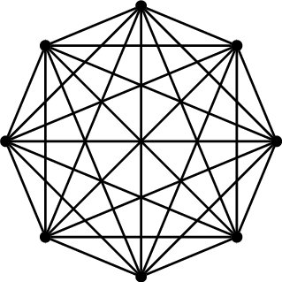
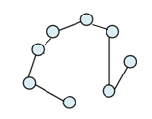
Prim or Kruskal?
Which one we should choose?
If the graph is complete or nearly complete, Prim performs faster O(ElogV)
In Kruskal: If the graph is spars (few edges), Kruskal gives O(ElogE)

